Slide 1

Capstone Minto Wheel Design
By: Nate DeLong, Davis Clemmons, Megan Bost, and Grayson Bush

Slide 2
Introduction
The need for clean energy is growing
In 2022 the world consumed 25,530 terawatt-hours of electricity
Number increases every year
In the same year, 1,539 million metric tons of Carbon Dioxide were produced in the United States alone
The Minto wheel is a heat engine that operates on a low temperature gradient and produces a massive amount of torque which can be converted to clean energy

Slide 3
How Does It Work?
Consists of a base, sealed containers with low-boiling liquid, a heat source, and hoses connecting the containers
Heat source is a warm-water bath
Half of the containers are filled with a low-boiling point liquid
Bottom containers heat when they dip into the warm-water reservoir and the liquid begins to vaporize causing vapor pressure upwards
Cooler containers condense the vapor and add weight, pulling the wheel forward
Produces torque or mechanical work that can be converted into energy

Slide 4
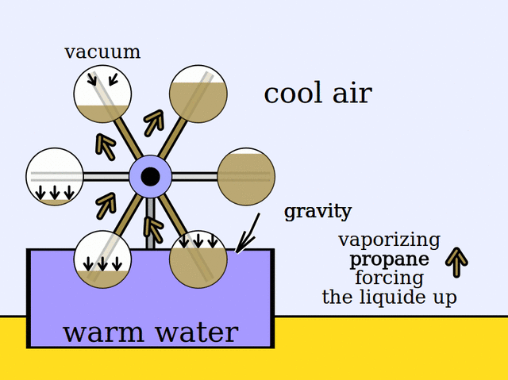
The Minto Wheel Process

Slide 5
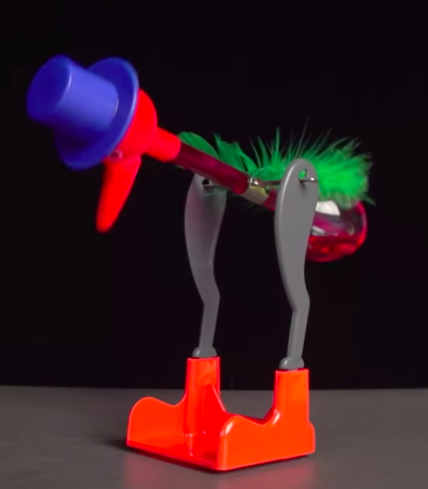
Background
1881: the Iske brothers and Israel L. Landis patented
thermodynamic engines that worked like the Minto wheel
1941: Karl Jauch patented a device called the “German Puja
Clock” that used a spinning wheel to act as the winding key
1945: Miles V. Sullivan patented the drinking bird which is a heat engine that works like an oscillating version of the Minto wheel
1976: Wallace Minto developed a wheel capitalizes off of mechanical and thermodynamic principles such as gravity and boiling points
1987: A derivation of Landis’s patent is the “Thermoscopic Balance '' that is a solar oscillating desk toy

Slide 6
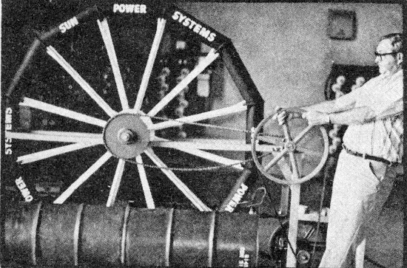
Wallace Minto & His Wheel

Slide 7
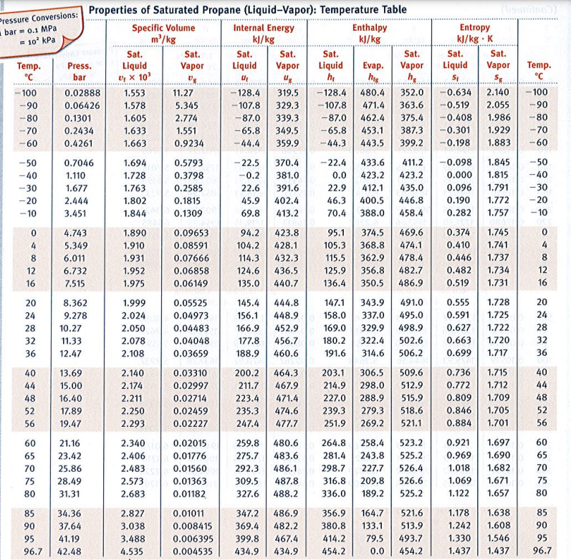
Previous Coursework
Thermodynamics- used to determine necessary temperatures of the water basin and pressures inside the tanks. Saturated mixture at given pressure
Steam Tables - Used typical pressure in tank and compared with steam table for propane to find boiling point.
Use of SolidWorks simulation

Slide 8
Design Process
Structural integrity of the Tanks was tested using a simulation
Tank dimensions and material based on known values - Alloy Steel
Unknown value - top fillet radius - conservative estimate 0.175 in
Max pressure is governed by release valve - 200 psi
One quarter of the tank was tested as it is symmetric
FOS of 3 needed to pass based on pressure vessel standards

Slide 9
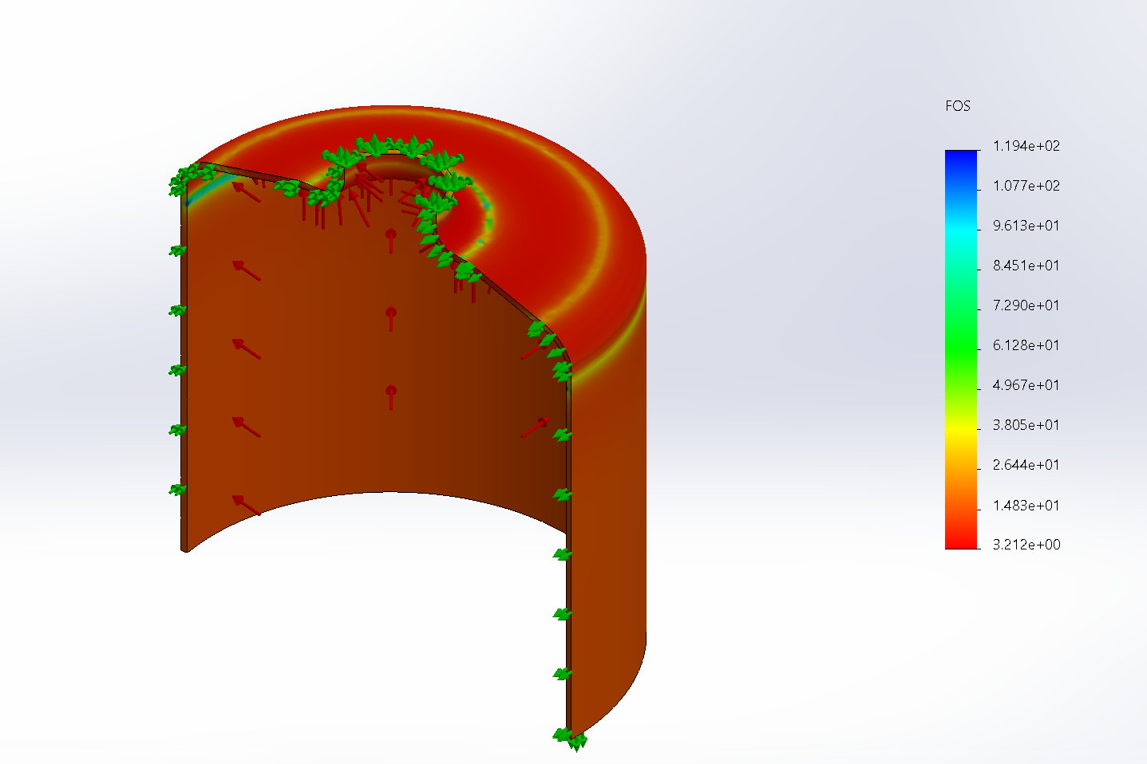
The SolidWorks Model
Yield Strength of Alloy Steel | Max Stress found in Simulation | FOS
90 ksi | 28 ksi | 3.21

Slide 10
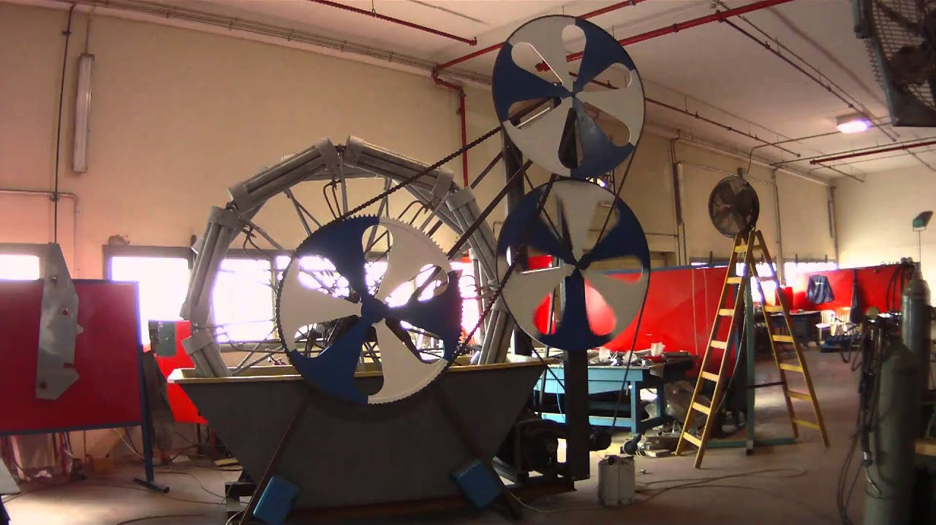
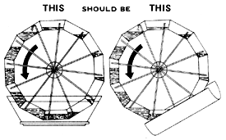
Alternative Solutions
Alternatives Considered:
Types of Liquid in tanks -Propane vs. R-134a vs. R-12
Cost Comparison:
Propane $0.44 per oz
R-134a $0.80 per oz
R-12 $4.40 per oz
Premade vs Constructed Tanks
Cost, Convenience, and Safety
Size and Orientation of the wheel: Any smaller would effect wheel function, any larger would require larger tanks

Slide 11
Cost & Economic Evaluation - Fluid Type
Cost Difference of Different Working Fluids
Propane is the cheapest and most readily available working fluid
R-12 | R-134a | Propane
$4.40 oz | $0.80 oz | $0.44 oz

Slide 12
Cost & Economic Evaluation - Individual Parts Cost
Part Description | Cost Per Unit | Number of Units | Total Part Cost
Full 16 oz propane bottles | $5.75 per bottle | 8 | $22.99
4 ft propane hose | $17.99 per hose | 4 | $71.96
Propane Tank Adapter | $10.00 | 4 | $40.00
1” 2 ft schedule 40 pipe | $9.00 per pipe | 2 | $18.00
Metal Ratchet | $10.00 per ratchet | 1 | $10.00
Heavy Base | Free | 2 | $0.00
Water container | Free | 1 | $0.00
Solar Water heater | Free | 1 | $0.00
Bike Wheel | $90.00 | 1 | $90.00
Tank Clamps | $6.00 | 8 | $48.00

Slide 13
Cost & Economic Evaluation - Total Parts Cost
Parts Total Cost | $323.96
Estimated Shipping + Tax | $150.00
Final Total Cost | $473.96

Slide 14
Professional, Ethical, and Code Concerns
Serve the public interest
Sustainable development for future generations
Maintain the highest standards of honesty and integrity
All communications will be truthful and transparent
No altering of the data and acknowledgement of errors
Hold paramount the safety and health of the public
Propane tanks are class 1 division 2 pressure vessels
Following the ASME Section VIII code of having a FOS of 3
Bleed off valve at 200 psi
Virginia fire code 6103.2.1.4: Propane can be used for research and experiments, but not in classrooms
Want to avoid this: https://www.youtube.com/watch?v=T-6f5AwRkOY

Slide 15
Major Design Constraints
Cost- Meeting a $500 budget, while also trying to create the lowest cost wheel as possible.
Time to Complete- Specific deadlines between two semesters kept the group on track to complete the project by May 13th, 2024
Temperature Gradient- restricted by artificial light from lamps or the sun and the solar water heater. The wheel must be able to work across small temperature differences

Slide 16
Summary of Constraints
Accessibility: could only use materials that were easily purchased
R-12 can’t be purchased by individuals
Aesthetics: This project did not focus on the aesthetics of the wheel only functionality
Codes: NSPE Code of Ethics
Constructability: No welding
Cost: $500 budget
Extensibility: only designed a working wheel, not what to do with energy produced
Functionality: Wheel designed to produce mechanical work
Legal Considerations: give credit and citations where they are due

Slide 17
Summary of Constraints
Maintainability: used bike wheel as frame for easy access
Manufacturability: hard without large factory to store all materials
Marketability: Easy to Market clean and effective energy
Schedule: complete by specified dates
Standards: see slide 12
Sustainability: wheel is permanently sustainable as long as water bath is hot
Usability: Simple design, easy to use

Slide 18
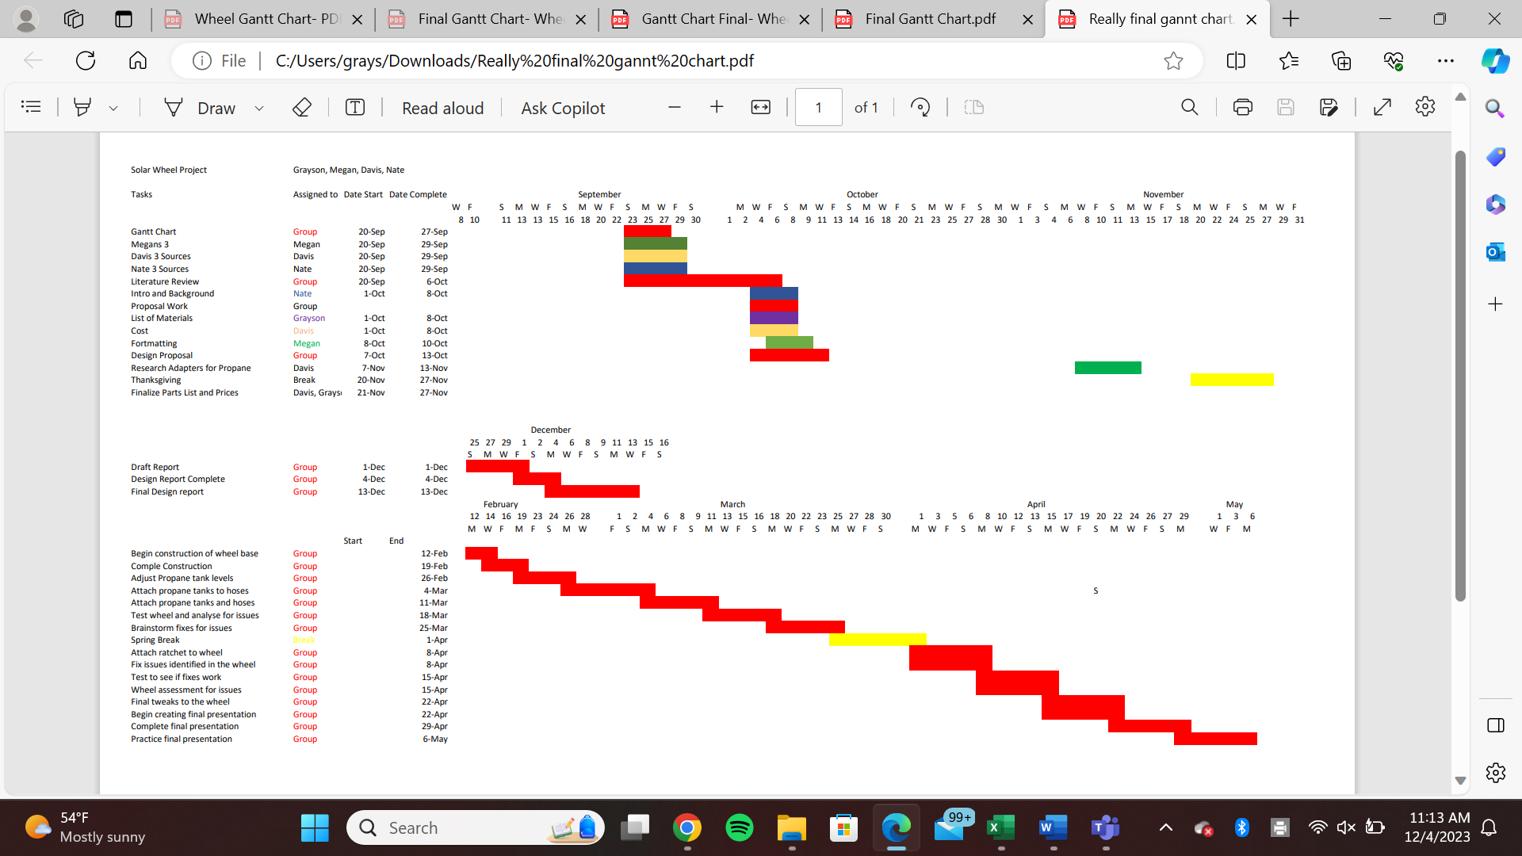
Schedule
Important Dates
February 12, 2024
Construction begins
March 18, 2024
Wheel prototype
April 22, 2024
Wheel is done
May 13, 2024
Final Presentation

Slide 19
References
Code of ethics. National Society of Professional Engineers. (2019). Retrieved November 27, 2023, from https://www.nspe.org/resources/ethics/code-ethics
Drinking Bird. Wikipedia. (2021, August 1). https://en.wikipedia.org/wiki/Drinking_bird
Editors, M. E. N. (n.d.). Solar engine: Wallace Minto’s newest invention – mother earth news. Mother Earth News – The Original Guide To Living Wisely. https://www.motherearthnews.com/sustainable-living/green-homes/solar-engine-zmaz76mazhar/
Editors, T. M. E. N. (1976, July 1). Mother puts Wally Minto’s solar wheel to the test – mother earth news. Mother Earth News – The Original Guide To Living Wisely. https://www.motherearthnews.com/sustainable-living/nature-and-environment/solar-wheel-zmaz76jaztak/
Frequently Asked Questions (FAQs) - U.S. Energy Information Administration (EIA). (2023, May, 1.) https://www.eia.gov/tools/faqs/faq.php?id=77&amp;t=11#:~:text=How%20much%20of%20U.S.%20carbon,of%20about%204%2C964%20(MMmt)
Published by Statista Research Department, & 19, S. (2023, September 19). Global Electricity Consumption 2022. Statista. https://www.statista.com/statistics/280704/world-power-consumption/

